Slide 1
Who needs cyber security?

Slide 2
Everyone who uses computers, the internet, and other digital devices needs cyber security. This includes individuals, businesses, organizations, and governments.
Tous ceux qui utilisent des ordinateurs, Internet et d'autres appareils numériques ont besoin d'une cybersécurité. Cela comprend les particuliers, les entreprises, les organisations et les gouvernements.

Slide 3
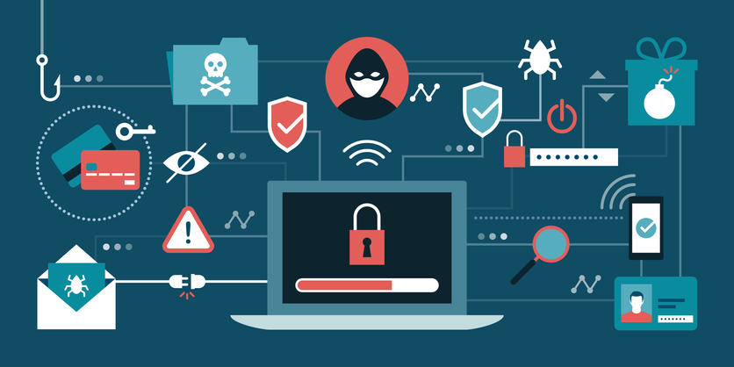
Individuals :
Anyone who uses a computer, smartphone, tablet, or any other digital device needs to be aware of cyber security threats and take steps to protect their personal information, such as passwords, financial data, and personal identification.
Quiconque utilise un ordinateur, un smartphone, une tablette ou tout autre appareil numérique doit être conscient des menaces de cybersécurité et prendre des mesures pour protéger ses informations personnelles, telles que les mots de passe, les données financières et l'identification personnelle.

Slide 4
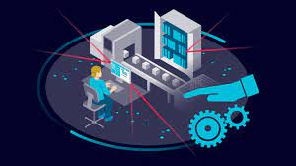
Organizations of all sizes need to protect their valuable data, intellectual property, financial information, and customer records. Without proper cyber security measures, they may fall victim to cyber attacks, resulting in financial losses, legal liabilities, and damage to their reputation.
Businesses
Les organisations de toutes tailles doivent protéger leurs précieuses données, leur propriété intellectuelle, leurs informations financières et leurs dossiers clients. Sans mesures de cybersécurité appropriées, ils peuvent être victimes de cyberattaques, entraînant des pertes financières, des responsabilités juridiques et des atteintes à leur réputation.

Slide 5
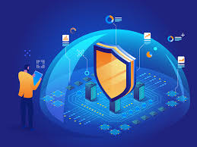
Organizations
healthcare providers, educational institutions, and government agencies are also vulnerable to cyber threats. In addition to protecting their sensitive data, they also have an obligation to protect the data of their clients, patients, students, and citizens.

Slide 6

Governments
Governments need to protect their classified information, critical infrastructure, and sensitive data, including military secrets, diplomatic communications, and personal information of citizens.

Slide 7
In summary, cyber security is essential for everyone who uses digital devices or is connected to the internet. It is a shared responsibility to keep ourselves and our data safe from cyber threats.

Slide 8
What are the consequences of a cyber attack?

Slide 9
The consequences of a cyber attack can be severe and can vary depending on the type and scope of the attack, the size of the organization, and the extent of the damage. Here are some of the possible consequences of a cyber attack:

Slide 10
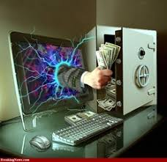
Financial losses
Financial losses: Cyber attacks can result in financial losses, including stolen funds, lost revenue, and costs associated with recovering from the attack.

Slide 11
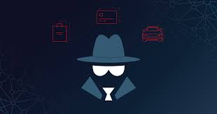
Damage to reputation:
A cyber attack can damage an organization's reputation, which can be difficult and costly to repair.

Slide 12
Disruption of operations:
Cyber attacks can disrupt an organization's operations, causing downtime, lost productivity, and other disruptions to the business.

Slide 13
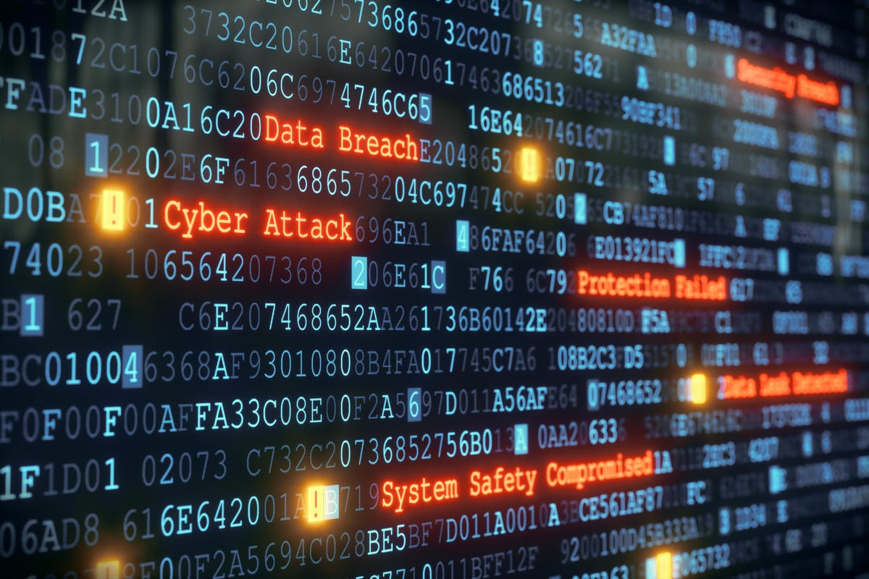
Data theft or destruction:
Cyber attacks can result in the theft or destruction of sensitive data, including financial data, personal information, and intellectual property.

Slide 14

Ransom demands:
Some cyber attacks involve ransom demands, where attackers demand payment in exchange for returning access to data or systems.

Slide 15
In summary, cyber attacks can have significant consequences for individuals, businesses, and governments. It is important to take steps to protect against cyber threats and to have a plan in place to respond to a potential attack

